Slide 1


Properties of Waves day 6
10/25 & 10/26

Slide 2
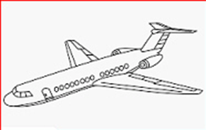
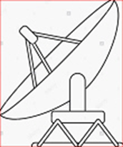

DQ
Waves in Communication Systems
An air traffic controller monitoring radar signals determines that an aircraft is flying at the wrong altitude. She communicates with the airplane’s pilot via radio to alert them about this..
Which two kinds of waves was the air traffic controller using, and what type of waves are they?
A. Microwaves and Gamma Rays. Microwaves and gamma waves are mechanical.
B. Radar waves and Radio. Radar is mechanical. Radio waves are electromagnetic.
C. Microwaves and Radio waves. Both of these are electromagnetic waves.
Standard 8.PS4.2

Slide 3
Share your research with your lab group
Turn in at the end of class
Completed Study Guides in TEAMS as homework. Make sure you turned in on TEAMS

Slide 4
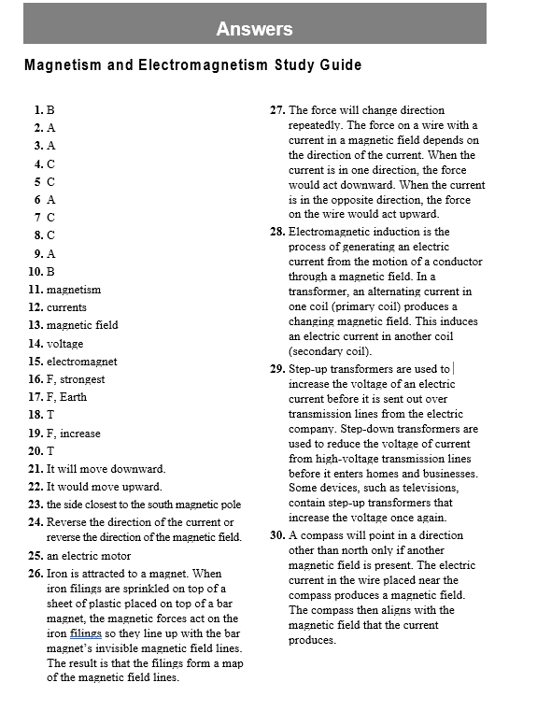

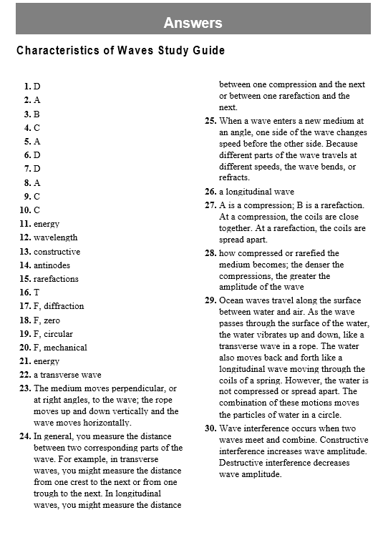
Review and check answers to Study Guides

Slide 5
Blooket Review
Electromagnetic Waves Blooket
Mechanical Waves Blooket
Communication Waves Blooket
Electric motors and generators Blooket
TEST this week!
1st, 2nd, and 3rd Wednesday
4th, 6th, and 7th Thursday

